Slide 1


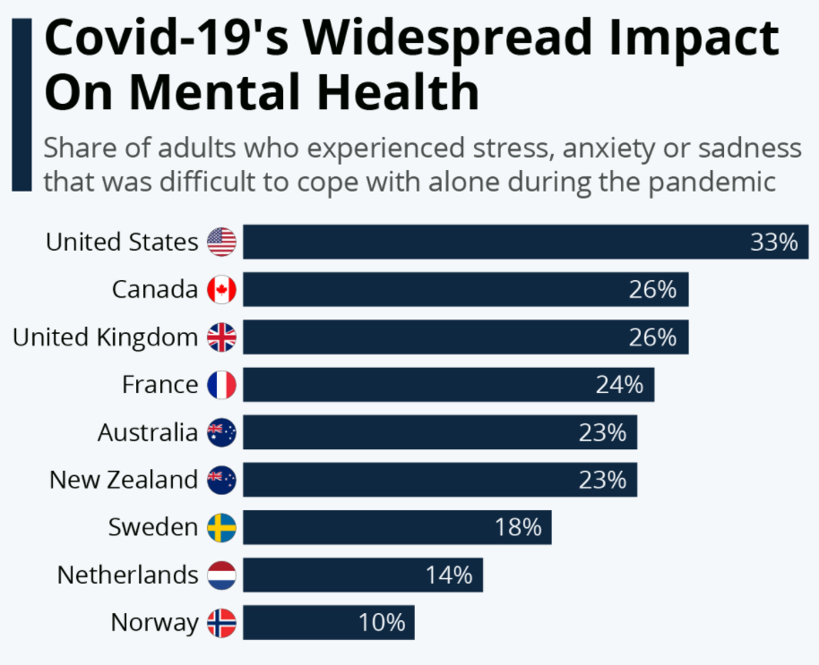


Mental Health and the COVID-19 Pandemic
Group# 9 (the-avengers)
Course project
UofT SCS Data Analytics Boot Camp 2021/22
*Copyright Disclaimer: All Links, Pictures, Logos and Contents are for fair educational use. All rights reserved to the copyright owners.

Slide 2




Project Topic: The effects of the COVID-19 pandemic on mental health Selection Criteria: Ongoing pandemic and its impact on mental health on various levels of communities
Group Members:
Mohamed El-Gazzar
Kyle Young
Sherry Lin
Irfan Sayeed
Team Communication and Collaboration: Communicating and collaboration are being done through Slack, Github channels and having Zoom meetings during scheduled class time and as on demand basis.
Source of Information:
Centers of Disease Control and Prevention (https://www.cdc.gov)
Canada Mental Health Teaching Hospital (https://www.camh.ca)

Slide 3
Survery Data Source: Covid related mental health Data is based on a factual house hold surveys conducted in USA within various level of communities
The U.S. Census Bureau, in collaboration with five federal agencies, launched the Household Pulse Survey to produce data on the social and economic impacts of Covid-19 on American households. The Household Pulse Survey was designed to gauge the impact of the pandemic on employment status, consumer spending, food security, housing, education disruptions, and dimensions of physical and mental wellness.
The survey was designed to meet the goal of accurate and timely weekly estimates. It was conducted by an internet questionnaire, with invitations to participate sent by email and text message. The sample frame is the Census Bureau Master Address File Data. Housing units linked to one or more email addresses or cell phone numbers were randomly selected to participate, and one respondent from each housing unit was selected to respond for him or herself. Estimates are weighted to adjust for nonresponse and to match Census Bureau estimates of the population by age, gender, race and ethnicity, and educational attainment. All estimates shown meet the NCHS Data Presentation Standards for Proportions.
Question: What group is most affected in terms of mental health due to the COVID-19 pandemic? Bereavement, isolation, loss of income and fear are triggering mental health conditions or exacerbating existing ones. Many people may be facing increased levels of alcohol and drug use, insomnia, depression and anxiety in various age group as well as in levels of community. People with pre-existing mental, neurological or substance use disorders are also more vulnerable to infection, they may stand a higher risk of severe outcomes and even death. "Good mental health is absolutely fundamental to overall health and well-being."

Slide 4

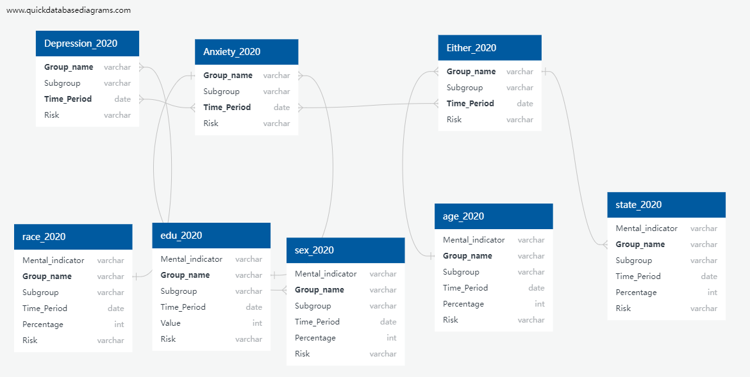
Database, Tables and ERD
We are using SQLite to established the database "Mental". The tables we are using are Depression_2020, Anxiety_2020, Either_2020, Sex_2020, Race_2020, Age_2020, Edu_2020, and State_2020.

Slide 5

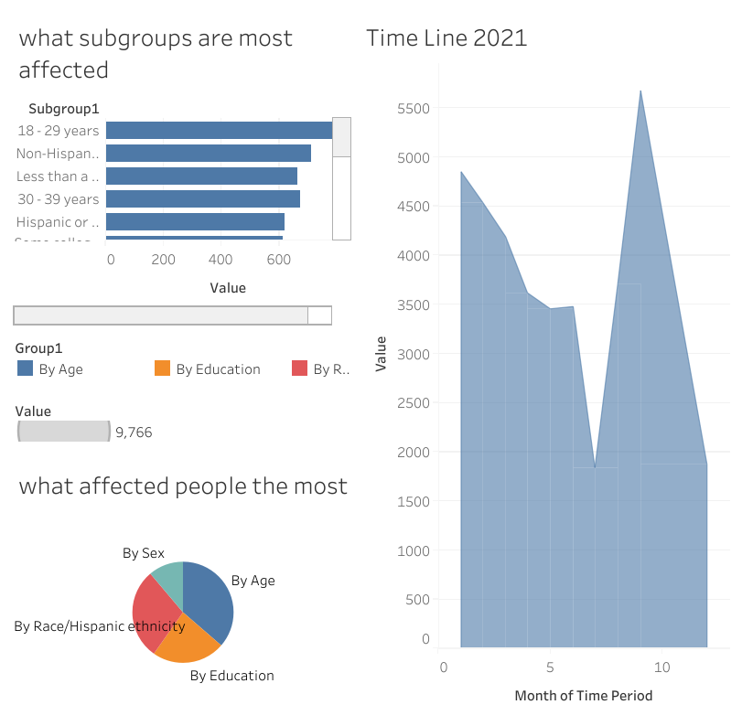
Depression Chart

Slide 6
Two content layout with table
First bullet point here
Second bullet point here
Third bullet point here
Class | Group 1 | Group 2
Class 1 | 82 | 95
Class 2 | 76 | 88
Class 3 | 84 | 90

Slide 7
Two content layout with SmartArt
First bullet point here
Second bullet point here
Third bullet point here
Step 3 Title
Step 2 Title
Step 1 Title

Slide 8
Add a Slide Title - 1

Slide 9
Add a Slide Title - 2

Slide 10
Add a Slide Title - 3

Slide 11
Add a Slide Title - 4

Slide 13
Add a Slide Title - 5

Slide 14
Add a Slide Title - 6

